Slide 1
E3
Microsoft 365
Security & Compliance
Platform
December 2020 update v.8.1
E5
E3
Click on row solution areas arrows
to enlarge & get more details
New Security & Compliance suites started on Feb. 2019 (*):
E5
E3
(*) These are supplemental (add-on) licenses with pre-requisite license requirements:
Microsoft 365 E3 or [EMS E3 + Offiice 365 E3]
E5
E3

Slide 2


Device Management & Protection
Windows Defender System Guard
is a set of security features designed to protect and maintain the integrity of the system as it starts up and after it's running, and to validate it through local and remote attestation.
Microsoft Endpoint Manager
is the convergence of Intune and ConfigMgr functionality and data—plus new intelligent actions—offering seamless, end-to-end management solution without the complexity of a migration or disruption to productivity.. In addition to Intune and ConfigMgr, Microsoft Endpoint Manager includes the Device Management Admin Center (DMAC) and Desktop Analytics
Microsoft Intune
is a cloud-based enterprise mobility management (EMM) service to enable your workforce to be productive while keeping your corporate data protected. Intune integrates with Azure Active Directory for identity and access control, and Azure Information Protection for data protection.
Choose between MDM for Office 365 and Microsoft Intune
Microsoft Intune and built-in Mobile Device Management for Office 365 both give you the ability to manage mobile devices in your organization. But there are key differences, described in the above link.

Slide 3
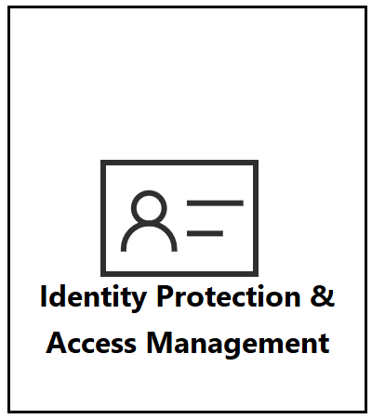
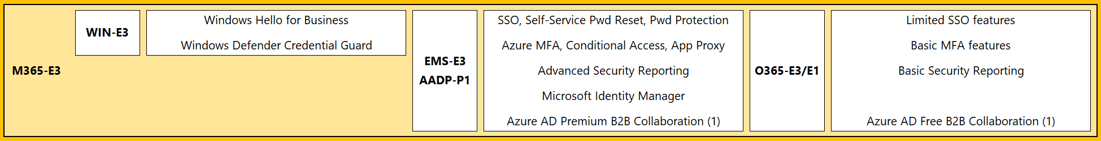
Identity Protection & Access Management in E3
Windows Hello for Business
WHfB replaces passwords with strong two-factor authentication on PCs and mobile devices. This authentication consists of a new type of user credential that is tied to a device and uses a biometric or PIN.
Windows Defender Credential Guard
WDCG uses virtualization-based security to isolate secrets so that only privileged system software can access them.
AZURE ACTIVE DIRECTORY Premium P1
Azure AD app management (SSO, App Proxy)
Azure AD Authentication (Azure MFA, Self-Service Pwd Reset, Password Protection)
Azure AD Conditional Access
Azure AD reports and monitoring
Azure AD B2B Collaboration
and more !!
(See AAD Pricing for Plan comparison)
(See AAD Pricing for Plan comparison)
(1) Azure AD B2B Collaboration: starting on September 1, 2020 this feature is licensed with a new Azure AD External Identities SKU

Slide 4
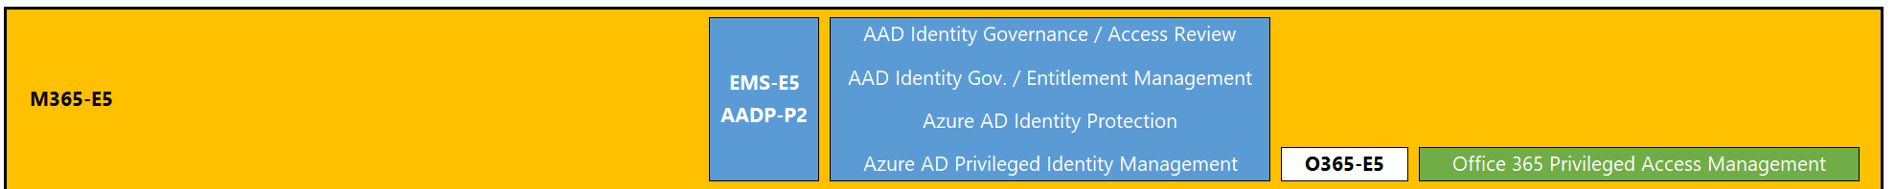
Identity Protection, Access Management & Governance in E5
AZURE ACTIVE DIRECTORY Premium P2
Azure AD Identity Governance
Entitlement Management
Access Reviews
Azure AD Identity Protection
Azure AD Privileged Identity Management (PIM)
(See AAD Pricing for Plan comparison)
Office 365 Privileged Access Management (PAM)
Privileged access management allows granular access control over privileged admin tasks in Office 365.

Slide 5
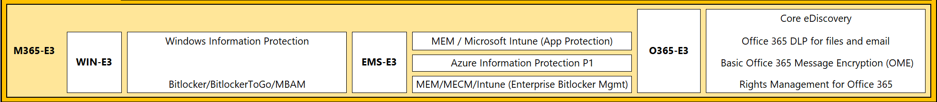

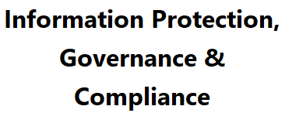
Information Protection in E3
Windows Information Protection (WIP)
WIP helps to protect enterprise apps and data against accidental data leak on enterprise-owned devices and personal devices that employees bring to work without requiring changes to your environment or other apps.
BitLocker
is a data protection feature that integrates with the OS and addresses the threats of data theft or exposure from lost, stolen, or inappropriately decommissioned PCs.
Azure Information Protection (AIP) P1
(See AIP Pricing Plan comparison)
Microsoft Intune (App Protection)
Microsoft Endpoint Manager / Microsoft Endpoint Configuration Manager / Microsoft Intune (Enterprise Bitlocker Management)
Office 365 eDiscovery
Office 365 DLP
Office 365 Message Encryption (OME)
AIP for Office 365 >> see AIP Pricing Plan Comparison

Slide 6
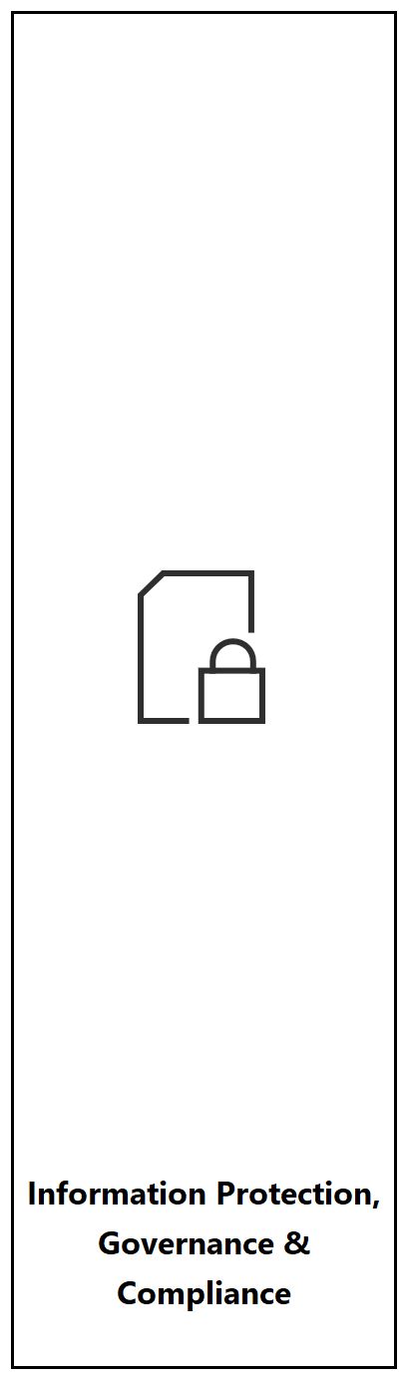
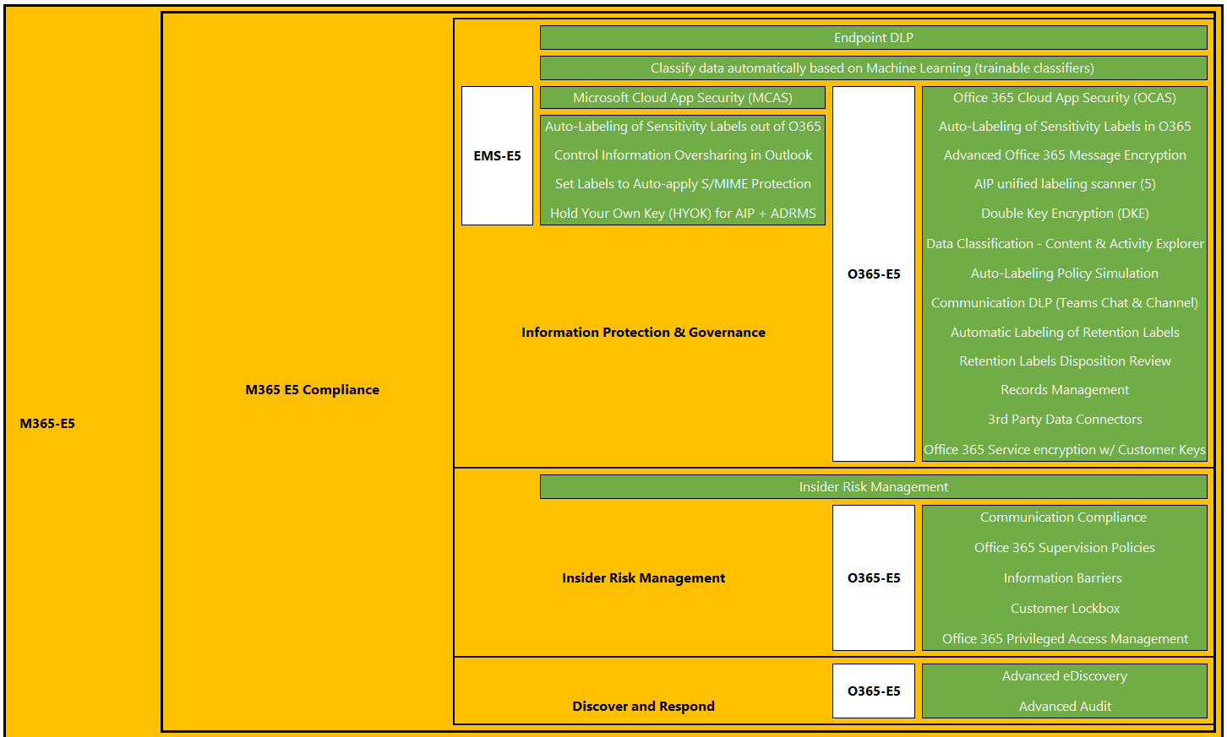

Information Protection, Governance & Compliance in E5

Slide 7

Information Protection, Governance & Compliance in E5
Microsoft Cloud App Security (MCAS)
Azure Information Protection (AIP) P2
(See AIP Pricing Plan comparison)
Trainable Classifiers
Microsoft 365 Endpoint DLP (data loss prevention)
Apply a sensitivity label automatically
Office 365 Advanced Message Encryption
AIP unified labeling scanner (5)
Double Key Encryption (DKE) for Microsoft 365
Data Classification – Content Explorer
Data Classification – Activity Explorer
Communication DLP (Teams channels & chats)
Automatically apply a retention label
Disposition Review
Records Management
3rd party Data Connectors
Service Encryption with Customer Key
Insider Risk Management
Communication Compliance
Information Barriers
Customer Lockbox
Office 365 Privileged Access Management
Advanced eDiscovery
Advanced Audit
(5) AIP unified labeling scanner: discovery mode and bulk labeling (with no content scanning or automatic classification involved) are also available in AIP P1

Slide 8
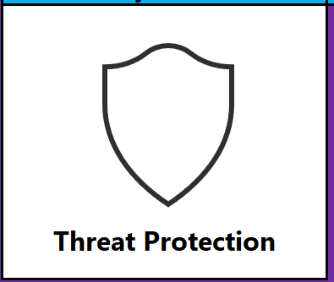
Threat Detection & Protection in E3
Microsoft Defender for Endpoint (E3)
Attack surface reduction
Next generation protection
Advanced Threat Analytics (ATA)
Office 365 anti-malware, anti-spam & anti-phishing in Exchange Online Protection (EOP)

Slide 9
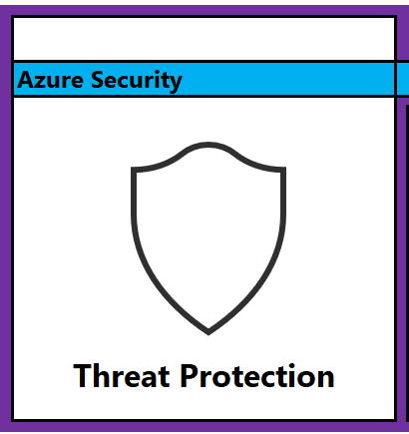
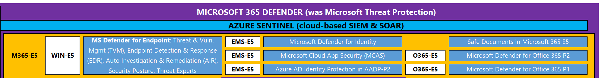
Threat Detection, Protection & Governance in E5
Microsoft 365 Defender
Microsoft Defender for Endpoint (E5):
Threat & Vulnerability Management
Endpoint detection and response
Automated investigation and remediation
Secure Score for Devices
Microsoft Threat Experts
Microsoft Defender for Identity
Microsoft Cloud App Security (MCAS)
Azure AD Identity Protection (in Azure AD Premium Plan 2)
Safe Documents in Microsoft 365 E5
Azure Sentinel (cloud-based SIEM & SOAR)
(* not included in Microsoft 365 licensing)
Microsoft Defender for Office 365 (P1 & P2)

Slide 10
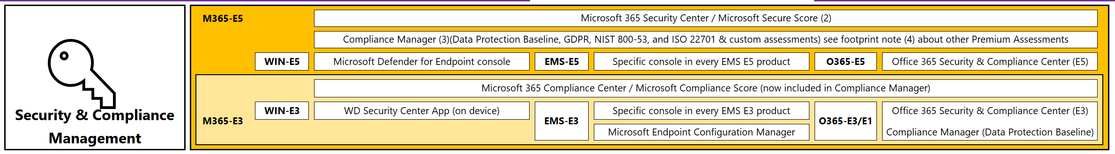
Security & Compliance Management
Microsoft 365 Security Center / Microsoft Secure Score (2)
Compliance Manager (3) (4)
Microsoft 365 Compliance Center / Microsoft Compliance Score (now included in Compliance Manager)
Windows Security App
Microsoft Endpoint Configuration Manager
Office 365 Security & Compliance Center (with notes about E3 and E5 components)
(2) Access to Microsoft 365 Security Center features is granted with any E5 product/bundle license
(3) Compliance Manager: the 4 out-of-the-box assessments and ability to make custom assessments are a benefit of Microsoft 365 E5 & Office 365 E5 licenses
(4) Compliance Manager: Access to premium templates currently freely available as a benefit of Microsoft 365 E5/Office 365 E5 will be subject to new licensing terms in the near future

