Slide 1
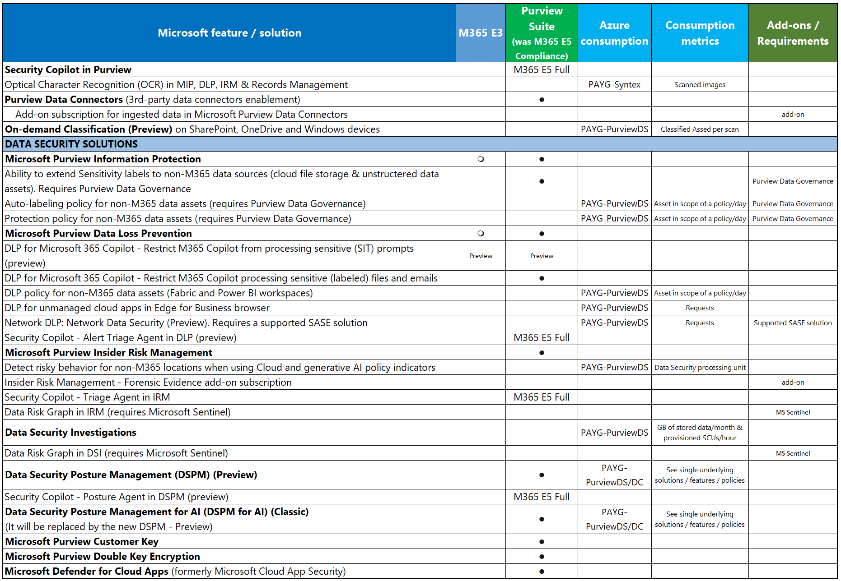

Microsoft’s data security, data compliance and data governance solutions with Microsoft Purview: new licensing overview with PAYG (1/2)
(2026-02_v1.0)

Slide 2
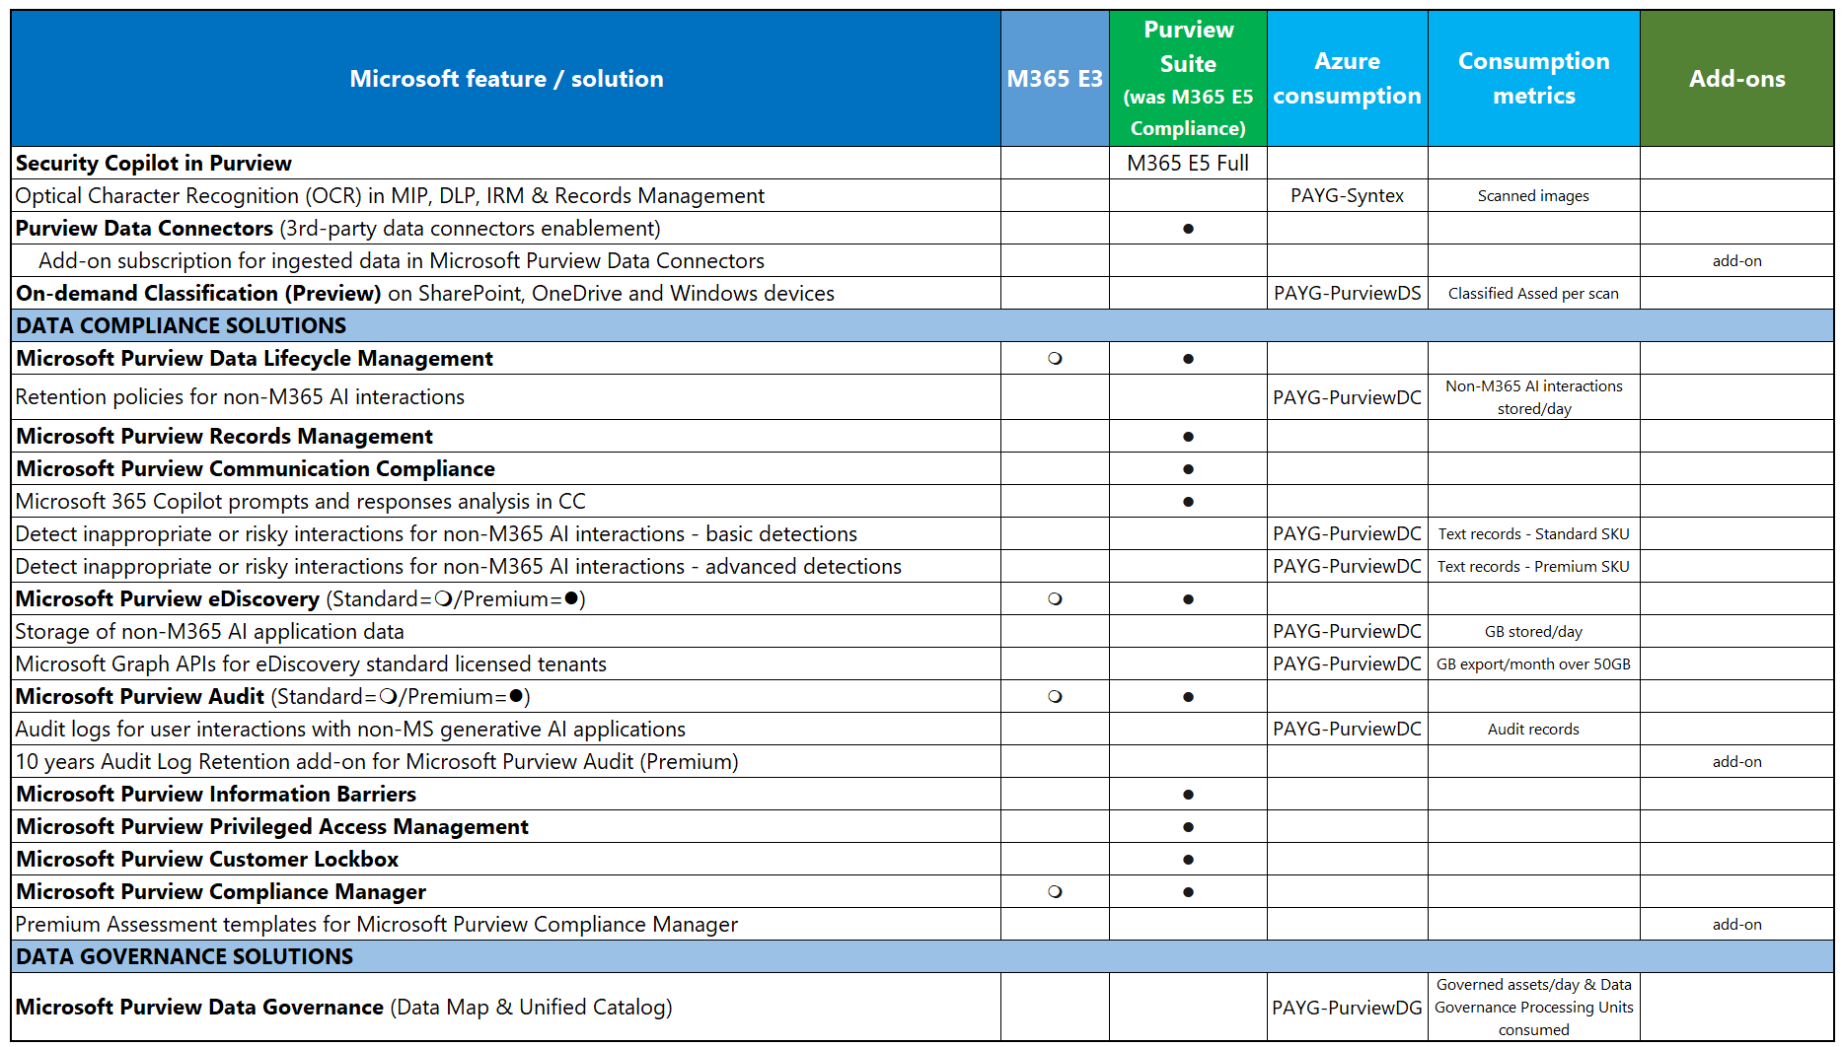
Microsoft’s data security, data compliance and data governance solutions with Microsoft Purview: new licensing overview with PAYG (2/2)
(2026-02_v1.0)

Slide 3
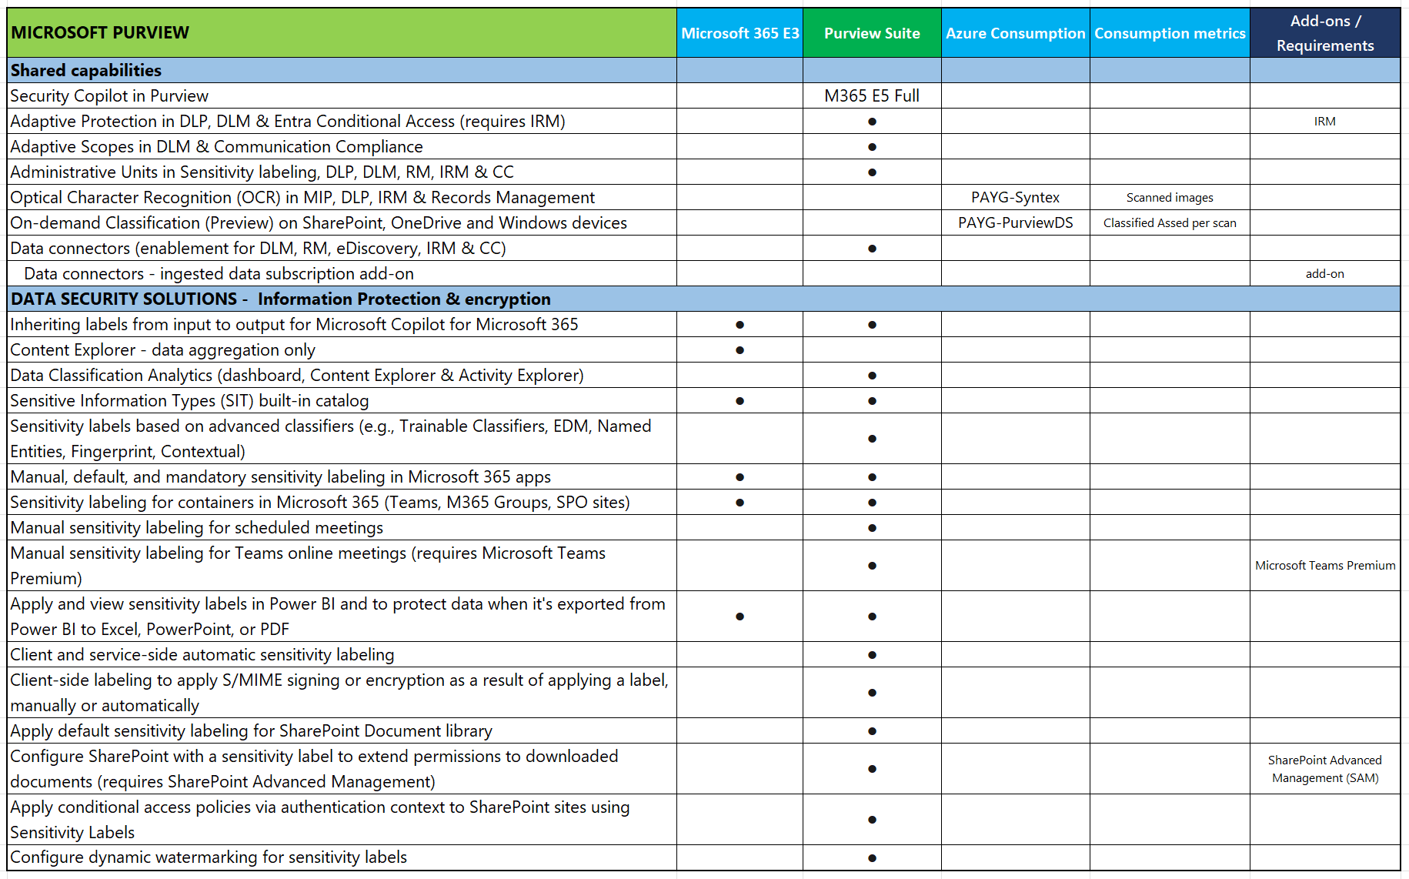
Microsoft’s data security, data compliance and data governance solutions with Microsoft Purview: new licensing overview with PAYG – detailed view (1/5)
(2026-02_v1.0)

Slide 4
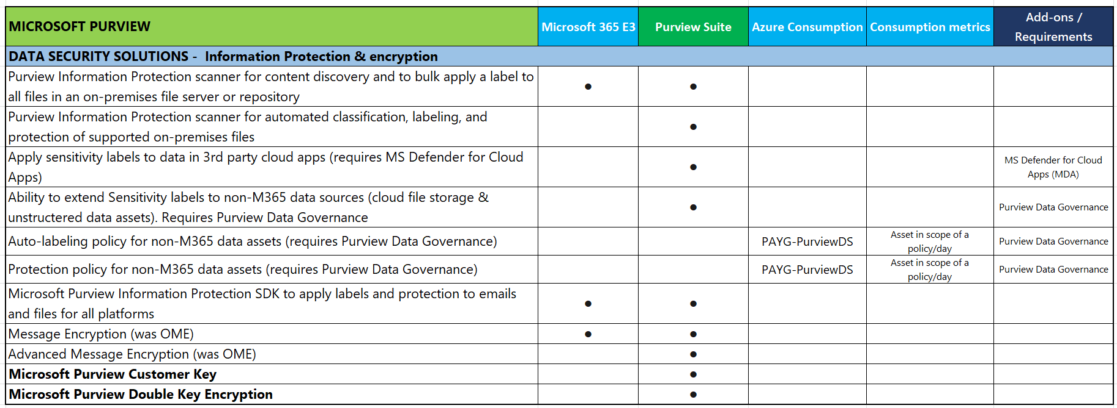
Microsoft’s data security, data compliance and data governance solutions with Microsoft Purview: new licensing overview with PAYG – detailed view (2/5)
(2026-02_v1.0)

Slide 5
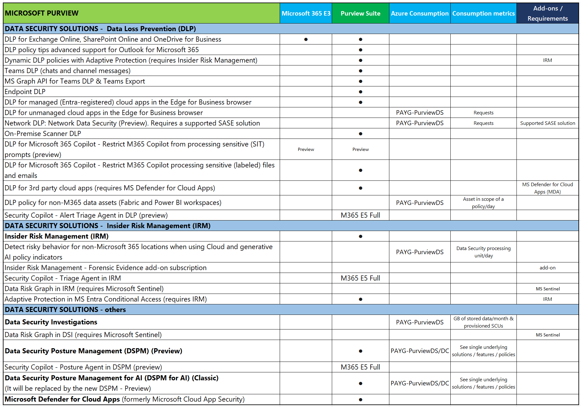
Microsoft’s data security, data compliance and data governance solutions with Microsoft Purview: new licensing overview with PAYG – detailed view (3/5)
(2026-02_v1.0)

Slide 6
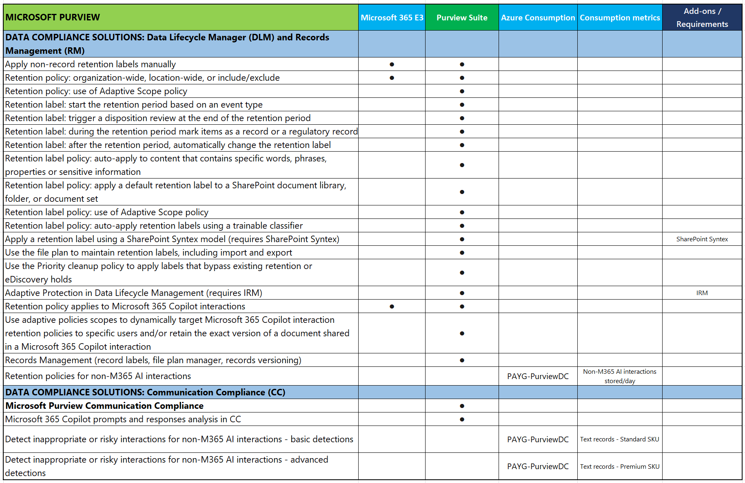
Microsoft’s data security, data compliance and data governance solutions with Microsoft Purview: new licensing overview with PAYG – detailed view (4/5)
(2026-02_v1.0)

Slide 7
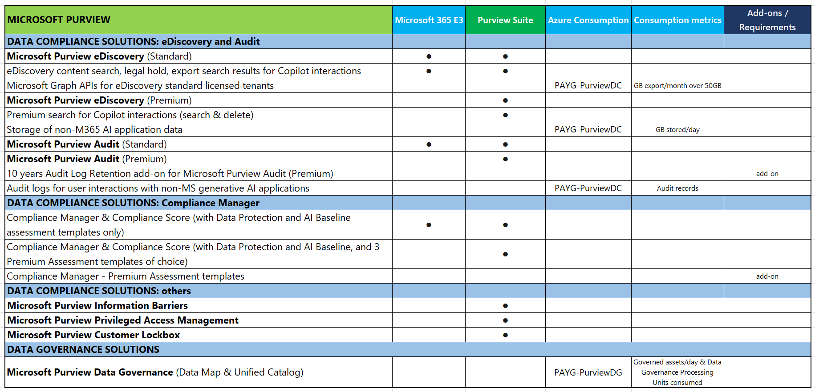
Microsoft’s data security, data compliance and data governance solutions with Microsoft Purview: new licensing overview with PAYG – detailed view (5/5)
(2026-02_v1.0)

Slide 8
References, Legend & Disclaimer
Microsoft Purview service description - Service Descriptions | Microsoft Learn
  Microsoft 365 Comparison table for Enterprise and Frontline Workers
Microsoft Purview | Microsoft Learn
  Learn about Microsoft Purview billing models | Microsoft Learn
Pricing - Microsoft Purview | Microsoft Azure
Legend:
PAYG-PurviewDS: Pay-as-you-go billing - Purview Data Security ACR
PAYG-PurviewDC: Pay-as-you-go billing - Purview Data Compliance ACR
PAYG-PurviewDG: Pay-as-you-go billing - Purview Data Governance ACR
PAYG-Syntex: Pay-as-you-go billing – Microsoft Syntex ACR
THESE DOCUMENTS ARE PROVIDED “AS IS”, WITHOUT WARRANTY OF ANY KIND, EXPRESS OR IMPLIED. THEY ONLY REPRESENT THE VIEW OF THE AUTHOR (ABOUT FELICIANO INTINI), WITHOUT ANY REVIEW OR ENDORSEMENT BY MICROSOFT

